Slide 1



HR ANALYTICS IN POWER BI
View in Power BI
Last data refresh:
7/21/2025 4:35:26 AM UTC
Downloaded at:
7/29/2025 7:08:48 AM UTC

Slide 2
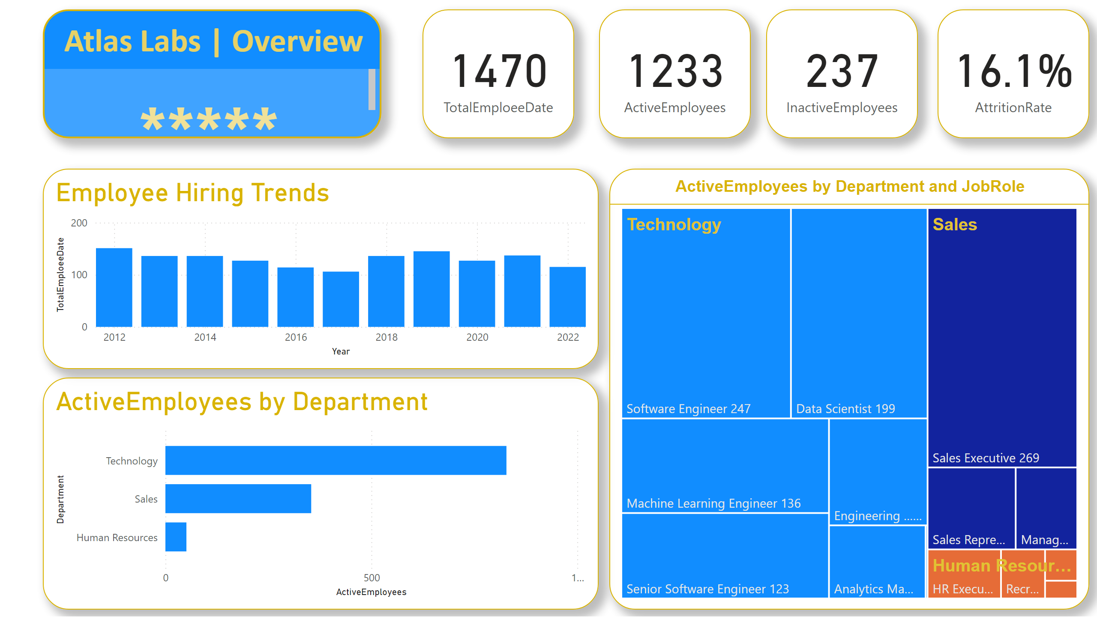
Overview
Notes:
Employee Hiring Trends
No alt text provided
barChart
No alt text provided
treemap
No alt text provided
card
No alt text provided
card
No alt text provided
card
No alt text provided
card
No alt text provided
Atlas Labs | Overview
No alt text provided

Slide 3
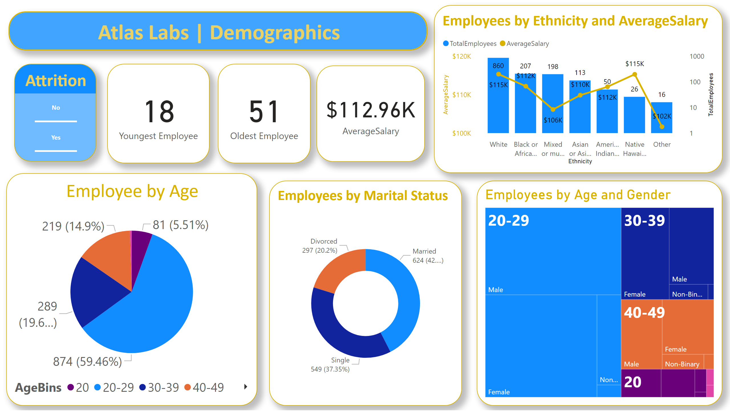
Demographics
Notes:
card
No alt text provided
card
No alt text provided
Employee by Age
No alt text provided
Employees by Age and Gender
No alt text provided
Employees by Marital Status
No alt text provided
card
No alt text provided
Employees by Ethnicity and AverageSalary
No alt text provided
Atlas Labs | Demographics
No alt text provided
Attrition
No alt text provided

Slide 4
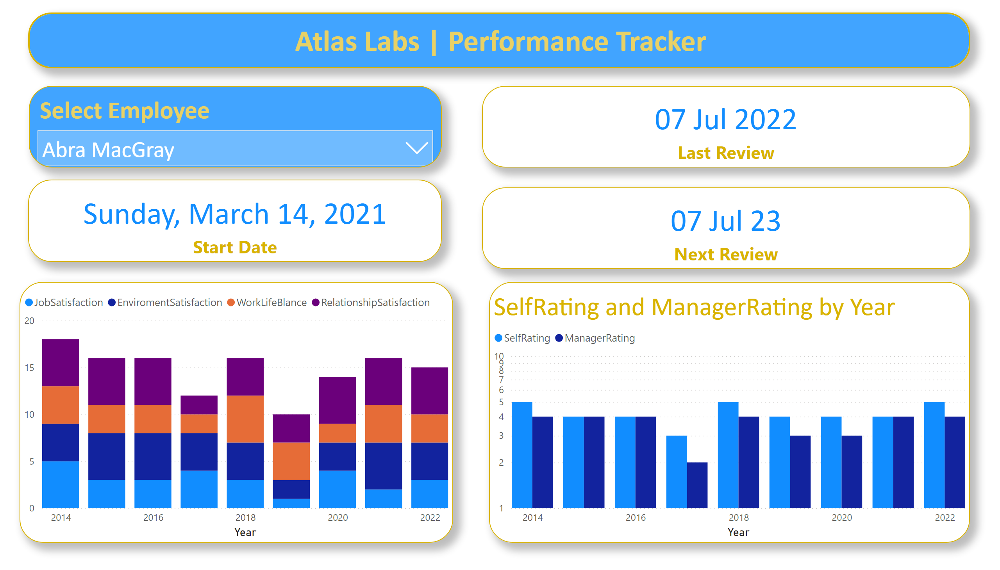
Performance Tracker
Notes:
Select Employee
No alt text provided
card
No alt text provided
card
No alt text provided
card
No alt text provided
lineStackedColumnComboChart
No alt text provided
clusteredColumnChart
No alt text provided
Atlas Labs | Performance Tracker
No alt text provided

Slide 5
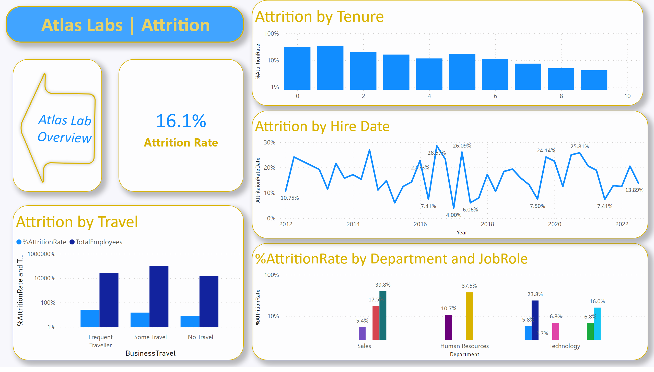
Attrition
Notes:
card
No alt text provided
clusteredColumnChart
No alt text provided
Attrition by Travel
No alt text provided
shape
No alt text provided
Attrition by Tenure
No alt text provided
Attrition by Hire Date
No alt text provided
Atlas Labs | Attrition
No alt text provided

